Slide 1
BLOCKCHAIN
Public-key Cryptography
Pr. TMIMI Mehdi

Slide 2


Main goal
Discuss the most fundamental aspects of a Blockchain:
Public Key Cryptography & one-way Functions

Slide 3
Cryptocurrency
In order to really understand how cryptocurrency works, we need to first understand Cryptography

Slide 4
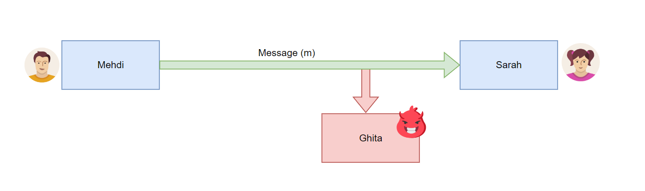
Encryption
Encryption is the oldest use for Cryptography
Mehdi wants to send a message 'm' to Sarah, but Ghita can intercept that message and read its content.
=> How can Mehdi send a message to Sarah without Ghita understanding the message ?

Slide 5
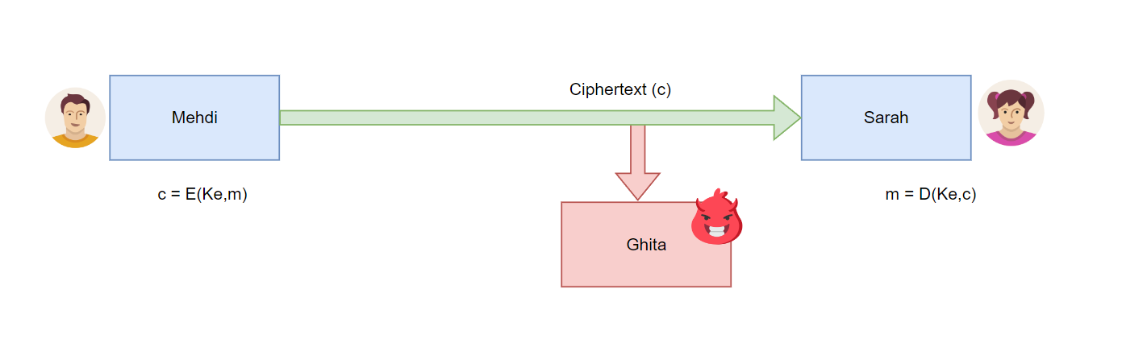
Symmetric-key Encryption
Mehdi and Sarah share the same secret Key: Ke.
Mehdi can encrypt the message using the encryption function and the secret key, then send the encrypted message (ciphertext c) to Sarah over the unencrypted channel.
Sarah can decrypt the ciphertext using the decrypt function and the secret key.
=> Ghita can only understand the message if she knows the decrypt function and also the secret key
E: Encrypt function
D: decrypt function
Ke: secret key
Ciphertext: encrypted message

Slide 6

Caesar Cipher
One of the simplest ciphers around
Given a key Ke (number in this case), all you need to do is to convert each letter of the message to its equivalent number, then add to it the Ke and performing a modulo operation according to the total number of alphabets.

Slide 7
Example: Caesar Cipher
Let's encrypt the message: RUNNOW using the secret Key: 4

Slide 8

Kerckhoff's Principle
The security of a system must only depends on the secret key not on the algorithm. => Security through obscurity is not a valid defense!
How could you break our caesar cipher, even if you don't know the key ?

Slide 9
Breaking Caesar
Frequency analysis.
Known plaintext attack
Brute force (there are really only 25 possibilities for our key)
Notes:
Frequency analysis : if we assume it's in the english language, we know that 'e' is the most common letter …..
Known plaintext attack: if we know one message and its encryption then we can figure out ….
=> So we can see that there are a variety of attacks that are possible on this very simple encryption system
There are other known attacks that are more complicated

Slide 10
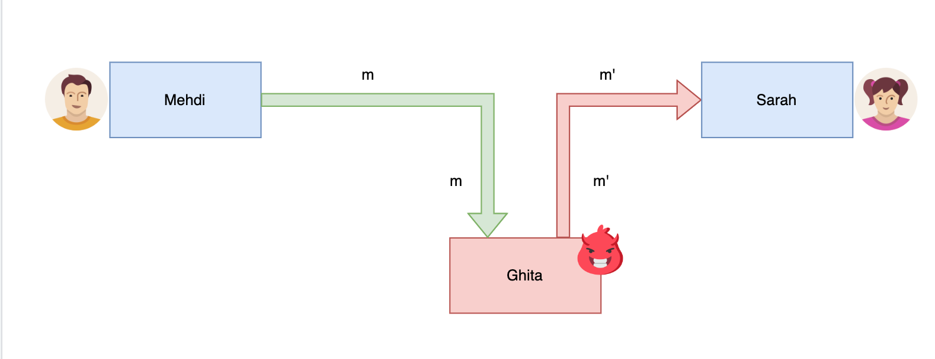
Authentication via Encryption
Let us assume that Ghita has gained the ability to modify traffic in-transit, or send a different message entirely.
=> How can Sarah verify that Mehdi sent the received message?
Notes:
An important thing other than just encryption that will be useful and important => authenticating via encryption

Slide 11
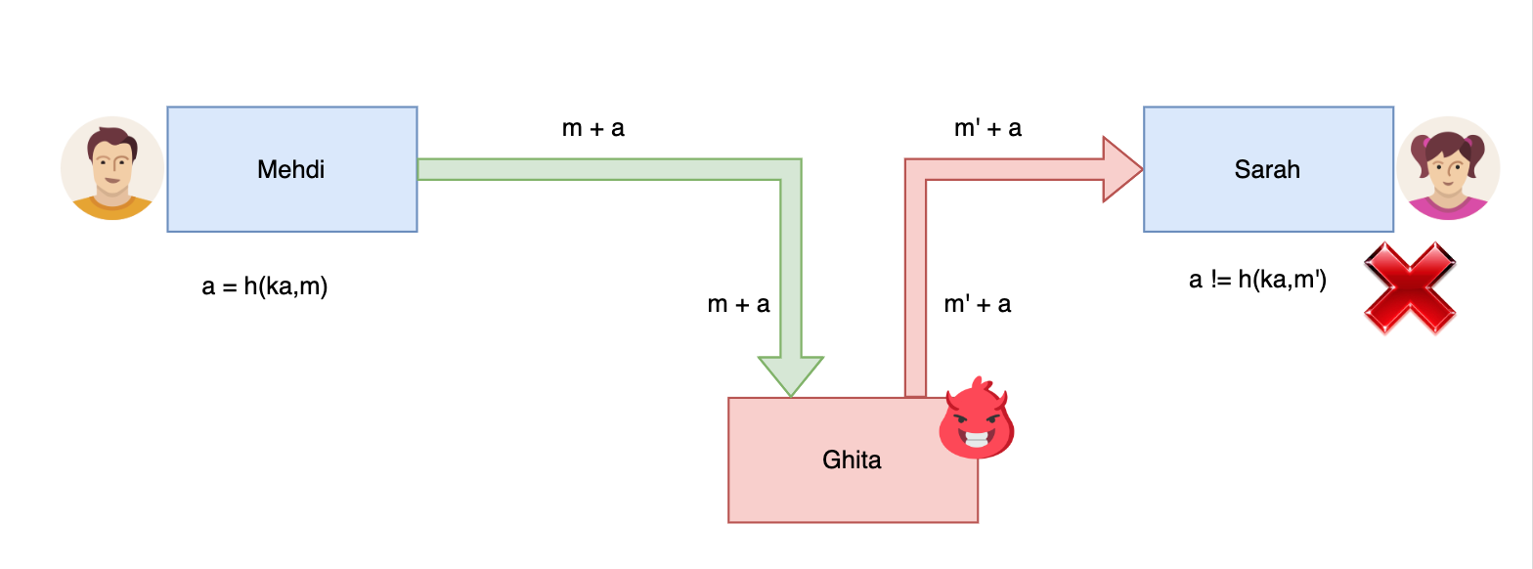
Authentication via symmetric-key Cryptography
Let us assume that Mehdi and Sarah share another secret key: K_{a} and know an authentication function h
Mehdi sends the message m which includes a message authentication code (MAC)
a = h(Ka,m)
When Sarah receives the message m, if h(Ka,m) doest not return a, she will know that it was not signed by Mehdi K_{a}
Notes:
An important thing other than just encryption that will be useful and important => authenticating via encryption

Slide 12
Authentication + Symmetric encryption
=> You can combine encryption and authentication by including the MAC (a) inside the ciphertext c and be able to:
Prove that a message came from a specific person.
Prevent others from reading the message.

Slide 13
Weakness of this approach
How can Mehdi and Sarah share the keys (encryption and authentication) ?
=> share them offline ? In a secure channel ?

Slide 14

Asymmetric key Encryption
We have two different keys: one (public key: P) to encrypt and the other (private key: S) to decrypt.
Your public key (P) is known by everyone and they can use it to send messages to you.
Only you using your private Key (S) can decrypt and read the message.

Slide 15
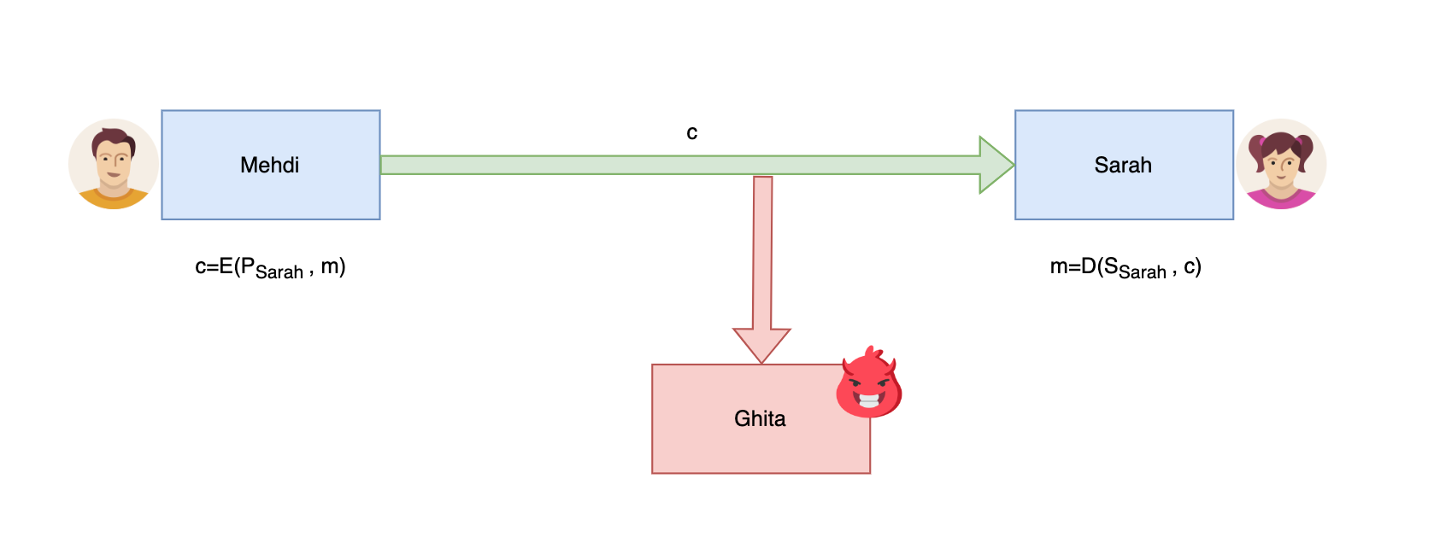
Authentication via symmetric-key Cryptography
Sarah tells the world about her public key (P_{Sarah}) but keeps her private key (S_{Sarah}) secret.
If Mehdi wants to communicate with Sarah, he needs to encrypt his message m to a cyphertext c using the function E.
The only and unique way to decrypt the message is with the function D which require Sarah's private key
Notes:
An important thing other than just encryption that will be useful and important => authenticating via encryption

Slide 16
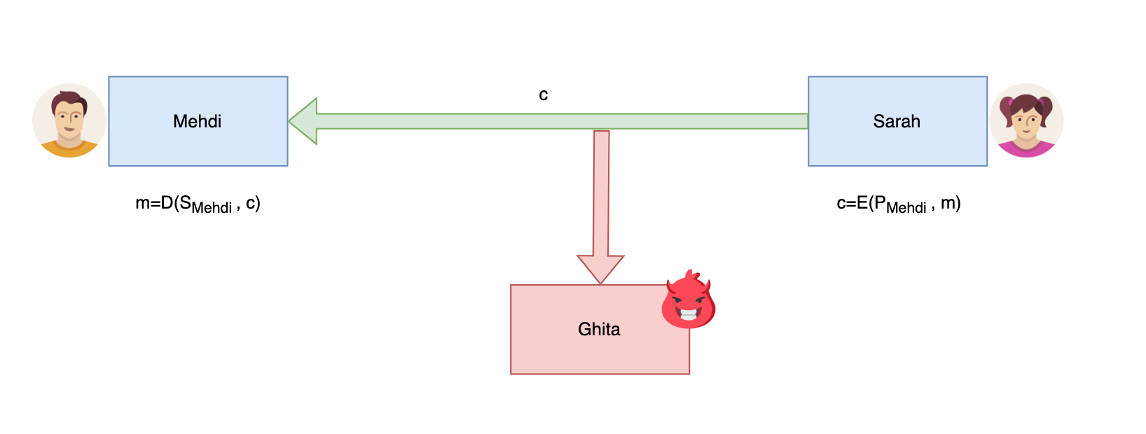
Secure Communication Without Secure Channels
Sarah can also communicate with Mehdi by using Mehdi's public key
=> Mehdi and Sarah can communicate over an insecure channel, even if from the start all communication is over that channel.
=> Ghita will only see the ciphertext c
Notes:
An important thing other than just encryption that will be useful and important => authenticating via encryption

Slide 17

Public/Private Key Generation
Public/Private keys share a relationship, they are not just two random values.
Bitcoin uses ECDSA to generate your key pair.
There are other possibilities such RSA
Notes:
ECDSA : Elliptic Curve Digital Signature Algorithm.

Slide 18
Efficiency
Turns out that asymmetric encryption itself is extremely inefficient in comparison to symmetric encryption.
=> use Hybrid Approach
Establish a secure communication using asymmetric encryption
Share a symmetric key encryption
Use now symmetric encryption for further communication

Slide 19
Public Key Infrastructure (PKI)
How you will be sure that P_{Sarah} is actually the public key of Sarah and not someone else.
=> certificate authorities, web of trust, SPKI, some blockchain-based approaches
In most Cryptocurrencies, there is no PKI. Meaning if you the private key => you own the coins of that public address.

Slide 20
One way function
A one way function (or trapdoor function) is a function y=f(x) where given y, it is computationally infeasible to calculate x. But given x, it's possible to calculate y.

Slide 21
One way function (Example)
Let's assume the function : y=f(x)=x²
Calculating the square is easy: f(33)=1089
However calculating the inverse is much more difficult.
=> Obviously the one way function that are used are much complex than just a square calculation (but the idea is the same)
Notes:
=> no function has been proven to be entirely one way, that's why we say it's computationnally infeasible ...

Slide 22
BLOCKCHAIN
Public-key Cryptography
Pr. TMIMI Mehdi

